Slide 1
Insurance Analysis

Slide 2
Introduction
The venerable insurance industry is no stranger to data-driven decision-making. Yet in today's rapidly transforming digital landscape, Insurance is struggling to adapt and benefit from new technologies compared to other industries, even within the BFSI sphere (compared to the Banking sector for example.) Extremely complex underwriting rule sets that are radically different in different product lines, many non-KYC environments with a lack of centralized customer information base, complex relationships with consumers in traditional risk underwriting where sometimes customer centricity runs reverse to business profit, inertia of regulatory compliance - are some of the unique challenges faced by Insurance Business.

Slide 3
Background
In this project, we will explore the US health insurance dataset and identify the key factors that drive the price of insurance premiums. To do this, we will leverage machine learning to model the relationship between the attributes of the insured and the price of their insurance premium. We will use that model to describe the importance of each attribute to the insurance premium.

Slide 4
About Data Set
This data appears to be a dataset relevant to insurance analysis, likely for health insurance. Here's how each column relates to insurance analysis:
Age:
Age is a crucial factor in determining insurance premiums. Older individuals typically face higher premiums due to increased health risks and potentially higher healthcare utilization.
Sex:
Gender can also influence insurance premiums. In some cases, insurance companies may charge different premiums based on gender due to variations in healthcare utilization patterns and risk factors.
BMI (Body Mass Index):
BMI is an indicator of body fatness and is often used by insurers as a measure of health risk. Higher BMIs are associated with increased risks of various health conditions, such as heart disease, diabetes, and certain cancers. Individuals with higher BMIs may face higher insurance premiums.
Children:
The number of children an individual has may influence their insurance needs and costs. Family policies often cover dependents, so individuals with more children may require more extensive coverage, which can affect premiums.

Slide 5
About Data Set
Smoker:
Smoking status is a significant determinant of health insurance premiums. Smokers typically face significantly higher premiums than non-smokers due to the increased risk of tobacco-related diseases and healthcare costs.
Region:
The geographic region can impact healthcare costs and insurance premiums due to variations in healthcare provider networks, cost of living, and regional health trends. Insurance companies may adjust premiums based on the region where the insured resides.
Charges:
The "charges" column likely represents the insurance charges or premiums paid by individuals in the dataset. This information is essential for insurers to assess revenue, claims experience, and profitability.

Slide 6
Data Collection
From Kaggle: US Health Insurance Dataset (kaggle.com)

Slide 7
Exploratory Data Analysis (EDA):

Slide 8
Exploratory Data Analysis (EDA):
Exploratory Data Analysis (EDA) serves as the critical first step in the data analysis journey. It lays the groundwork for deeper analysis and statistical modeling. We will examine our dataset to ensure its quality and readiness for subsequent analysis. We will undertake the following essential tasks:
Determine the dataset's dimensions, revealing its size and shape.
Ascertain the data types present across all columns.
Measure the extent of missing values within the dataset.
Identify and count any duplicate entries.
Compile descriptive statistics for each column to understand data distributions.
Compute the correlation coefficients between variables to uncover relationships.
Plot histograms for each variable to visualize their frequency distributions.
Generate scatterplots to explore potential correlations between variables.
Compare the distribution of premium charges across age, gender, and their number of children.

Slide 9
Exploratory Data Analysis (EDA):
Datatypes
age (continuous) - The age of the insured.
bmi (continuous) - The body mass index of the insured.
children (discrete) - The number of children of the insured.
sex (categorical/binary) - The gender of the insured.
smoker (categorical/binary) - Status of insured if smoker or not.
region (categorical) - The region where the insured lives.
charges (float) - The premium charges of the insured
Missing Value and Duplicated Data
The dataset does not contain missing values.
The dataset only contains one duplicated row. However, since we do not know if this data comes from the same person, we won't be dropping that row.

Slide 10
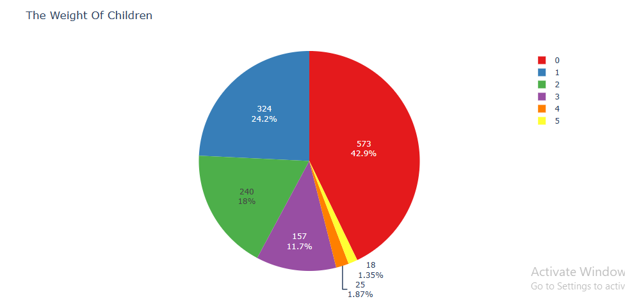
Exploratory Data Analysis (EDA):

Slide 11
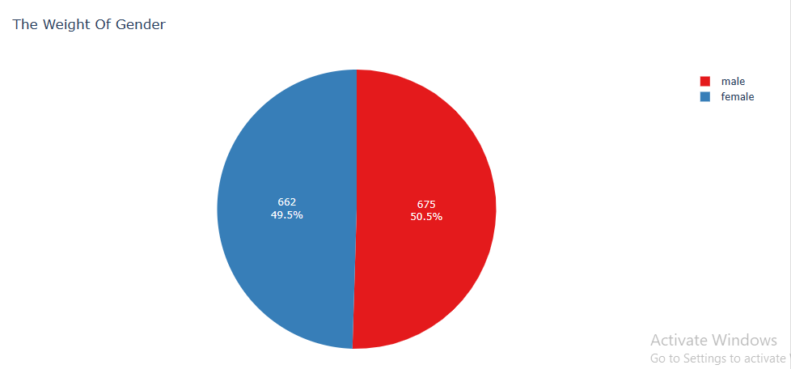
Exploratory Data Analysis (EDA):

Slide 12
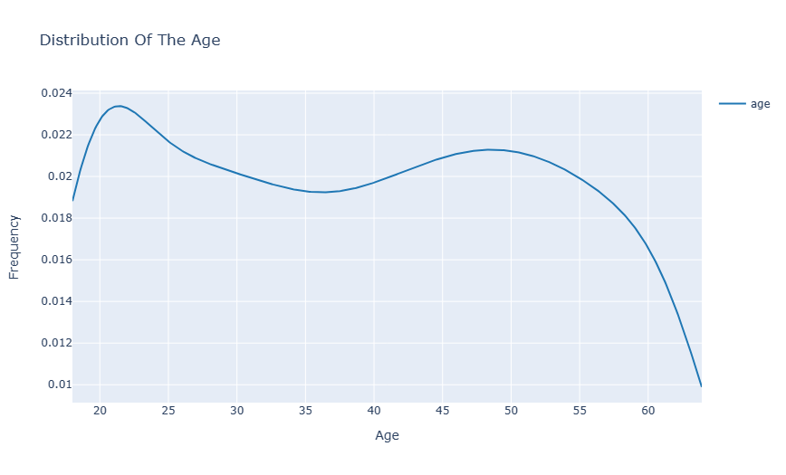
Exploratory Data Analysis (EDA):

Slide 13
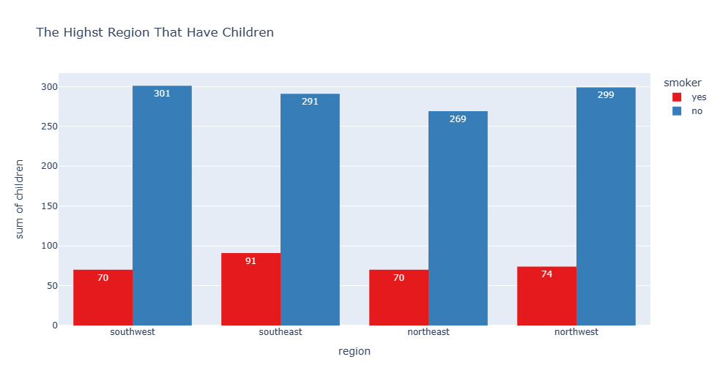
Exploratory Data Analysis (EDA):

Slide 14
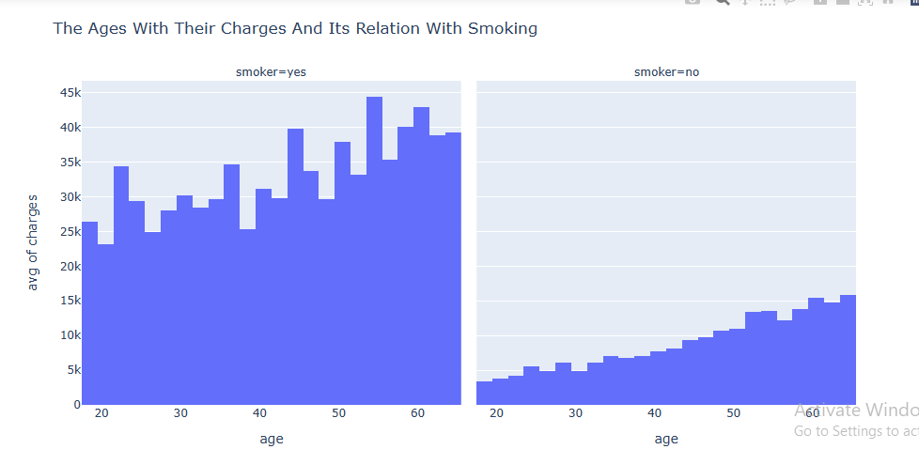
Exploratory Data Analysis (EDA):

Slide 15
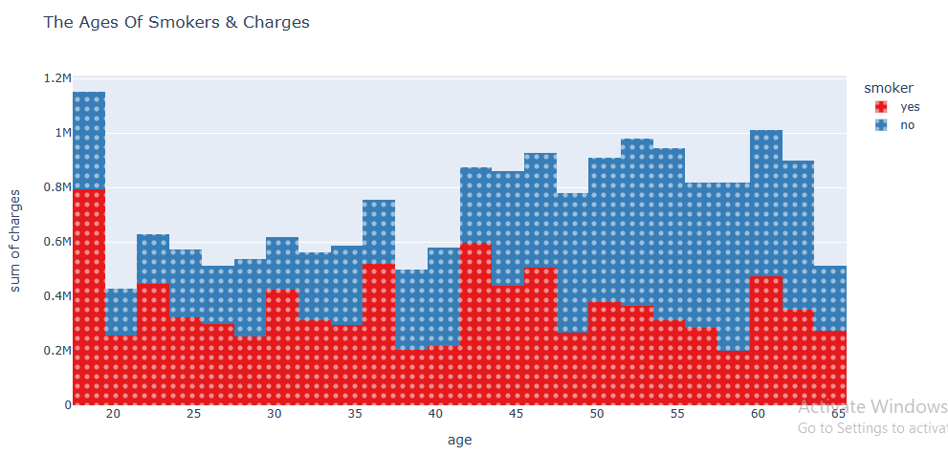
Exploratory Data Analysis (EDA):

Slide 16
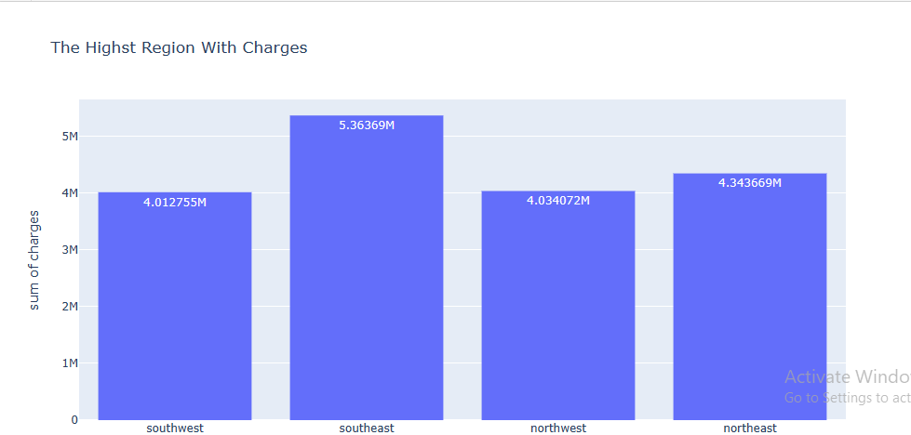
Exploratory Data Analysis (EDA):

Slide 17
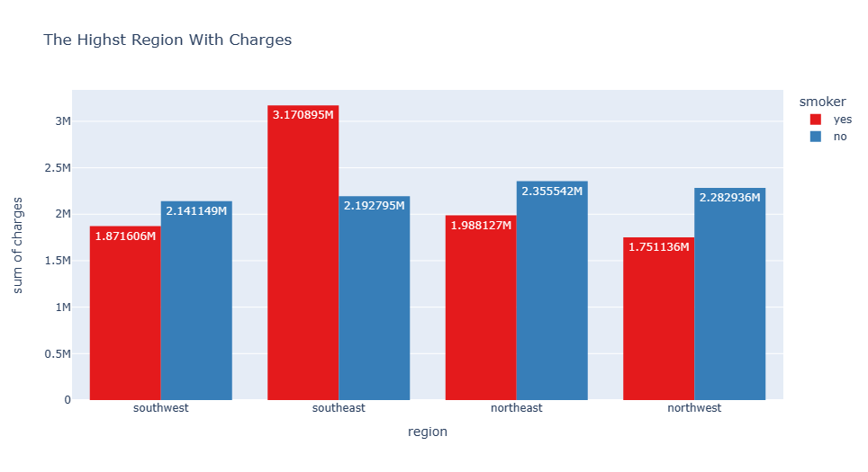
Exploratory Data Analysis (EDA):

Slide 18
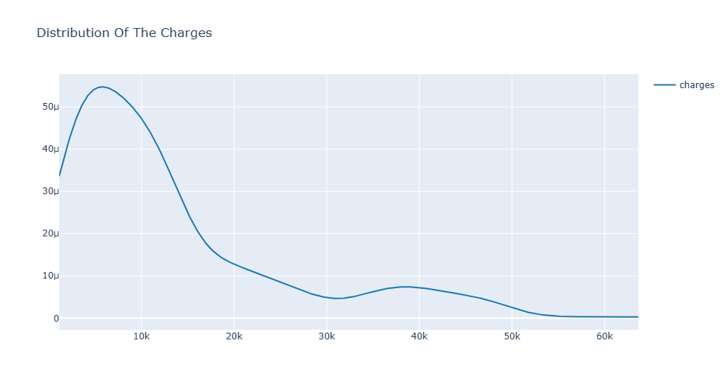
Exploratory Data Analysis (EDA):

Slide 19
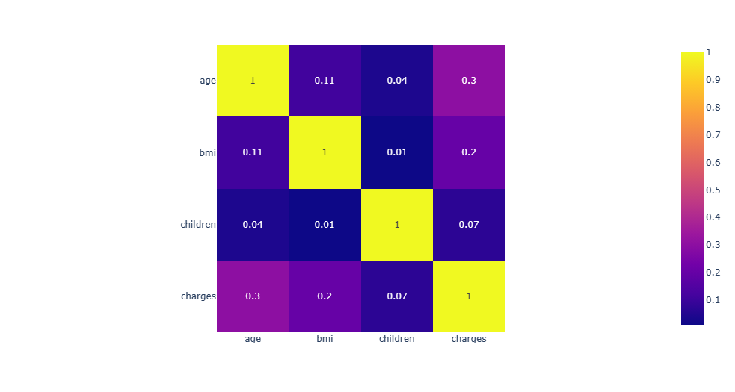
Exploratory Data Analysis (EDA):

Slide 20
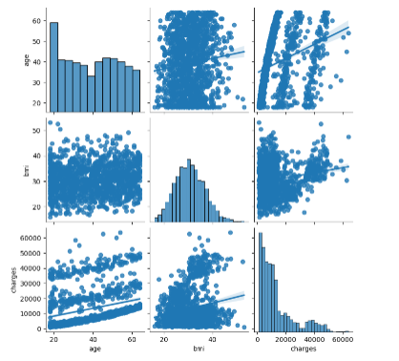
Exploratory Data Analysis (EDA):
Above pairplot shows that the distribution of age was uniformly distributed, the distribution of bmi was normally distributed, and the distribution of charges was highliy skewed with long tails on the right. We can also observe that indeed the age was correlated with charges but not linearly.

Slide 21
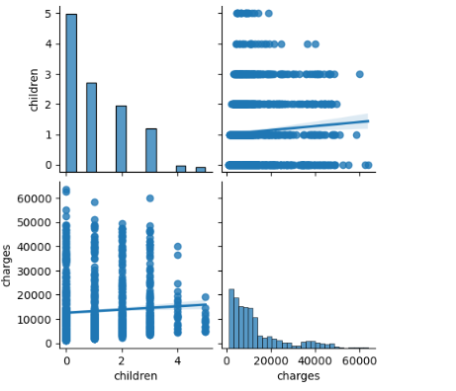
Exploratory Data Analysis (EDA):
Above visualization shows that majority of the insured does not have children. In addition, the slope of the regression line with respecto to charges appears to almost horizontal. This indicates a weak relationship between the two as what we observed with the correlation matrix.

Slide 22
EDA Summary
All in all, using exploratory data analysis, we found that our dataset does not contain missing data and alarming duplicate records.
During our data visualization, we found that the charges variable was highly skewed to the right -- this skewness might affect some of our machine-learning models.
We also found that our dataset has a class imbalance problem on the smoker variable wherein only 20% of its samples contain data for smokers.
To deal with these issues, it is suggested that we conduct a log transformation on the charges dataset to normalize its distribution on the log scale.
For the class imbalance issue, we will evaluate the use of both undersampling and oversampling

Slide 23
Modelling

Slide 24
Modelling
During our exploratory data analysis, we found the top three attributes with weak to medium correlation with charges. In this section, we will quantify the effects of these variables on charges by fitting an interpretable model. In this project, we will only be dealing with the two most interpretable models in the machine learning landscape. Linear Regression Decision Trees

Slide 25
Modelling
Linear Regression
Let's start with the simplest model. To model our data in a linear regression model, we need to perform the following tasks: Split the dataset into training, evaluation, and testing set. The training set will be used for training, the evaluation will be used for hyperparameter tuning, and the test set will be used when comparing different models. Scale the values of the numerical features using StandardScaler. This is subject for cross-validation. Encode the categorical features using OneHotEncoder. Normalize the target variable on the log-scale using log-transformation. To do these task, we can build an ML pipeline that can streamline all of these steps in one go

Slide 26
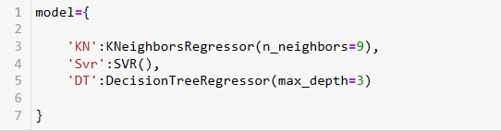
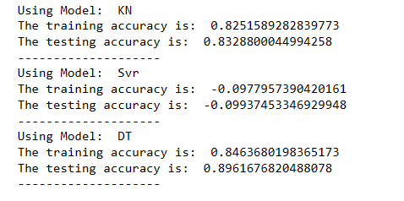
Other Modeles
We found that the DT model is better than the others

Slide 27
Conclusions
In this project, we conducted exploratory data analysis and built both linear regression and decision tree models to identify the key attributes affecting premium charges. Our best prediction performance was achieved using a Decision Tree with a depth of 3 layers.

Slide 28
Top Factors
Based on our modeling results, the top 4 attributes influencing premium charges are:
Smoker: Whether the insured is a smoker or not.
Age: The age of the insured.
Children: The number of children.
BMI: Body Mass Index.

Slide 29
Conclusions
Smoker's Premium Charge
Non-smoker's Premium Charge
For smokers, the price of their premium primarily depends on the interaction between their BMI and age. Smokers with an obese BMI tend to face higher premium charges.
Non-smokers’ premium charges are mainly influenced by their age, number of children, and BMI. Individuals in their early 20s with no children and a BMI within the healthy to overweight range have the lowest premium prices. As insured individuals age or have more children, the insurance premium increases.

Slide 30
Recommendations
In this straightforward project, we identified and quantified the impact of key factors on premium charges.
For smokers seeking health insurance, we recommend developing a plan to quit smoking, maintaining a healthy diet, and exercising to keep their BMI within the healthy range—ultimately leading to lower insurance premiums.
Non-smokers aiming for lower premiums should start early and focus on maintaining a healthy BMI.

Slide 31
Thank You

